Slide 1

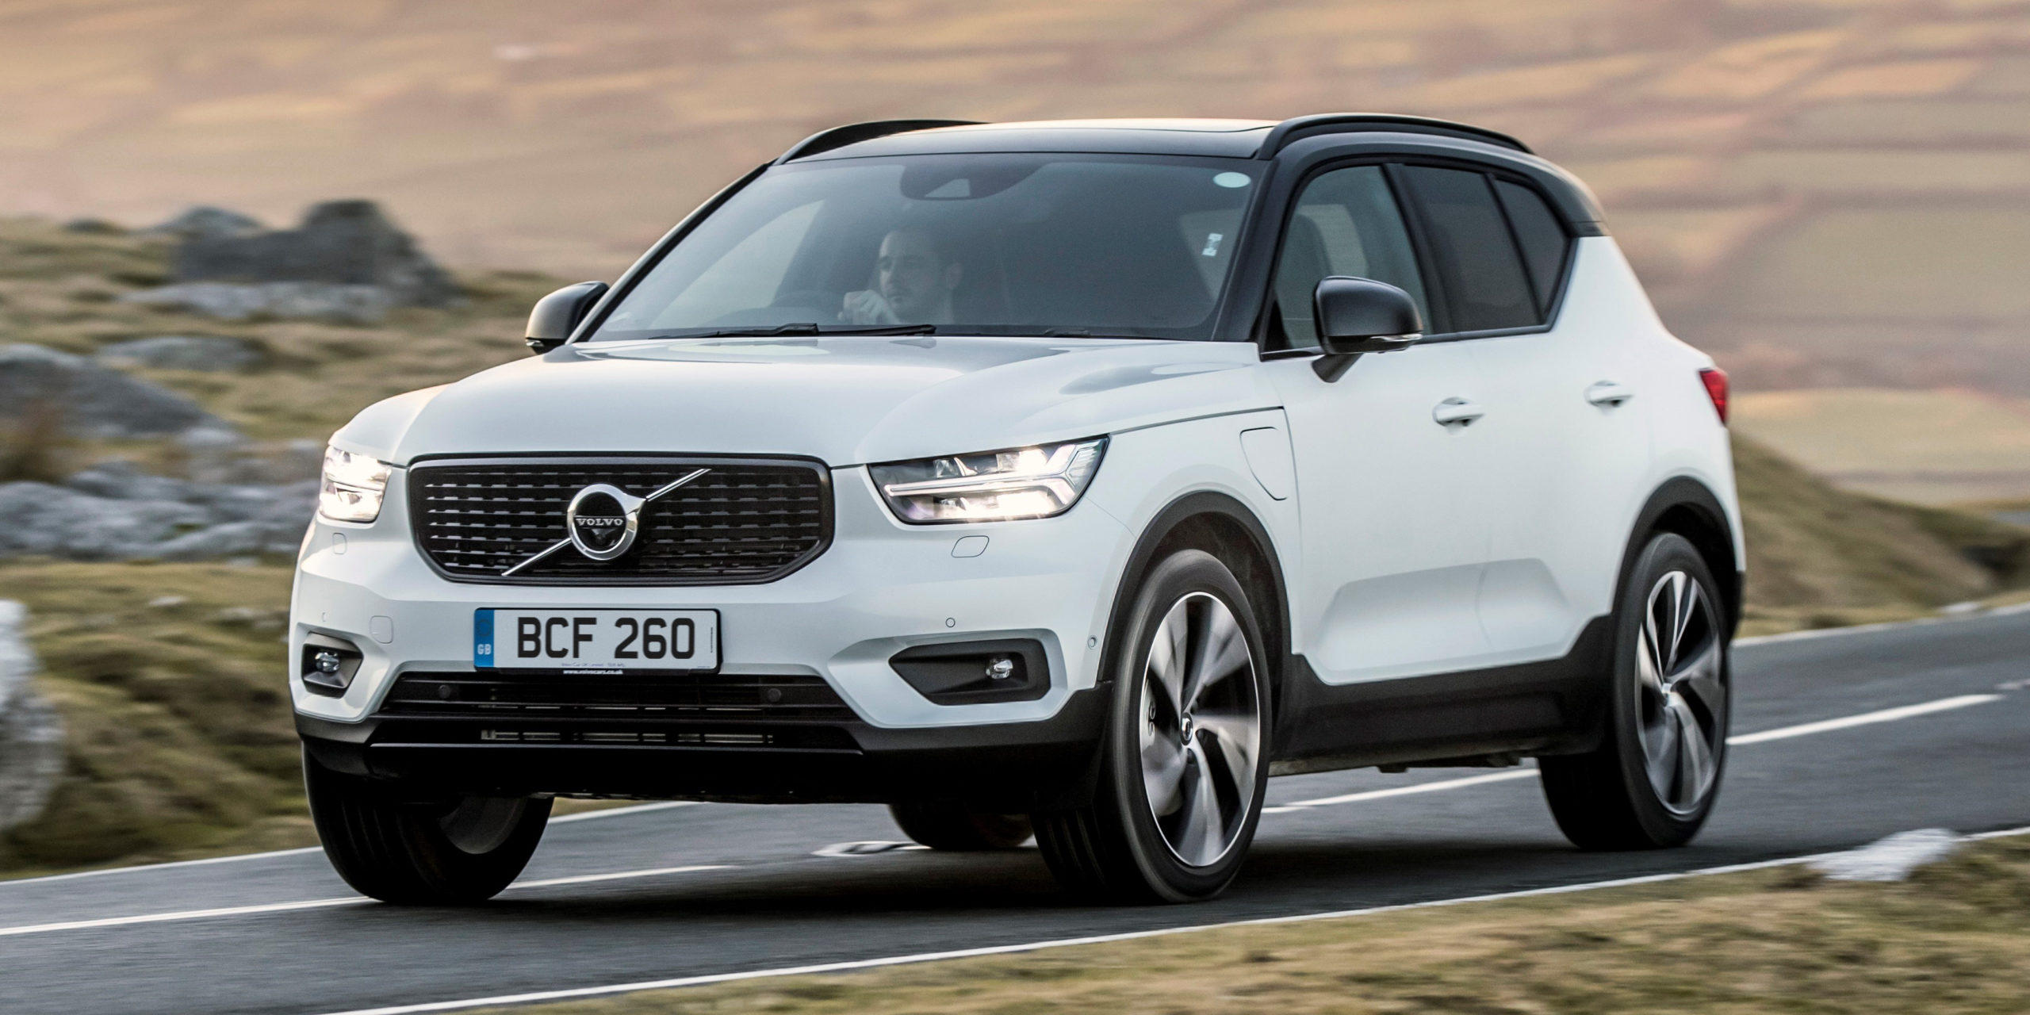

Used Car Price Prediction
Varsha Thakur

Slide 2
Abstract
Car price prediction has picked researchers' interest since it takes a significant amount of work and expertise on the part of the field expert. For a dependable and accurate forecast, a large number of unique attributes are analysed. We employed 6 different machine learning approaches to develop a model for forecasting the price of used automobiles. The respective performances of different algorithms were then compared to discover the one that best suited the existing data set. The final prediction model was implemented in a python programme.

Slide 3
Problem statement
With the Coronavirus sway on the lookout, we have seen lot of changes in the vehicle market. Presently some vehicles are sought after subsequently making them exorbitant and some are not popular consequently less expensive. With the adjustment of market due to Coronavirus 19 effect, people/sellers are facing issues with their past Car Price valuation AI/Machine Learning models. Along these lines, they are searching for new AI models from new information. Here we are building the new car price valuation model.
The primary point of this venture is to create a dataset with the help of web scraping and anticipate the cost of trade-in vehicle in view of different elements.

Slide 4
Collecting the data
We have scraped the data for over 5000 cars using Selenium script from 4 different websites from different different locations around the country. The websites are as followed:
1. OLX
2. Cars24
3. CarDekho
4. Autoportal

Slide 5
There are 9 columns:
'Brand & Model' : It gives us the brand of the car alongwith its model name and manufacturing year
'Varient' : It gives us the varient of particular car model
'Fuel Type' : It gives us the type of fuel used by the car
'Driven Kilometers' : It gives us the total distance in kms covered by car
'Transmission' : It tells us whether the gear transmission is Manual or Automatic
'Owner' : It tells us the total numbers of owners car had previously
'Location' : It gives us the locaion of the car
'Date of Posting Ad' : It teels us when the advertisement for selling that car was posted online
Price : It gives us the price of the car.
Here Price is our target variable.

Slide 6
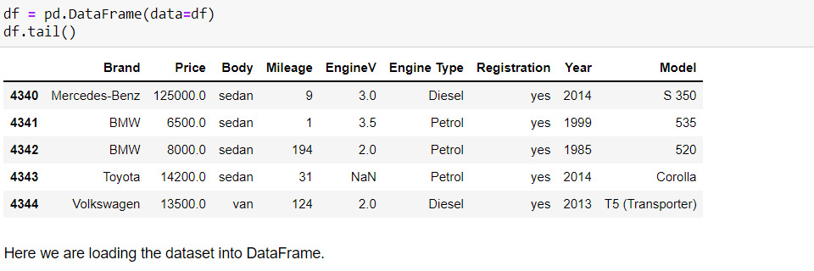
Reading the dataset
Now we read the dataset into Pandas and since the target column ‘Price’ is of integer datatype, we will apply regression algorithms on it.

Slide 7
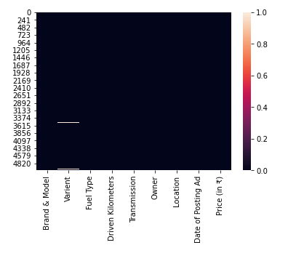
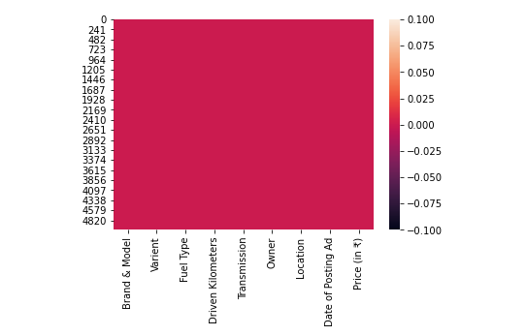
Data Cleaning
We check for null values and find that there are few in column ‘Varient’ and we will treat them with Mode.
Since all the features are categorical hence we need not check for outliers and skewness.
Before treating null values
After treating null values

Slide 8
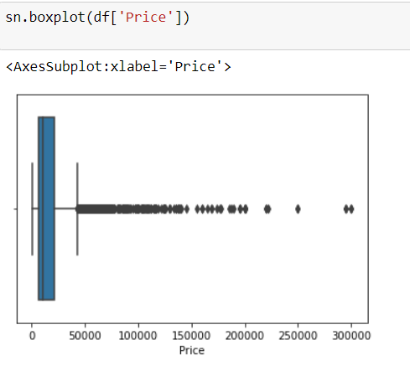
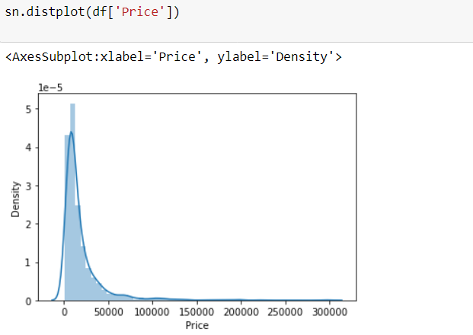
Exploratory data analysis
Firstly, we will plot boxplot and distribution plot for target variable. And find that there are few outliers which need not be treated and the data is tightly distributed with almost nomalized distribution.

Slide 9
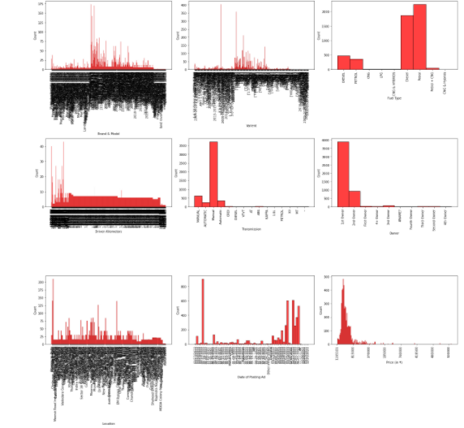
Histogram
~ Brands, Varients, Driven Kilometers & Location have a wide range of values in them.
~ Maximum Cars run on either Petrol or diesel. Only few goes for CNG and other fuels.
~ Maximum Cars have Manual transnission.
~ Maximum cars are being sold by their very 1st Owner.
~ We have collected the cars posted online in last one month, from 25th December 2021 to 27th January 2022.
~ Almost all the cars have a price ranging in between 6100 to 199999.

Slide 10
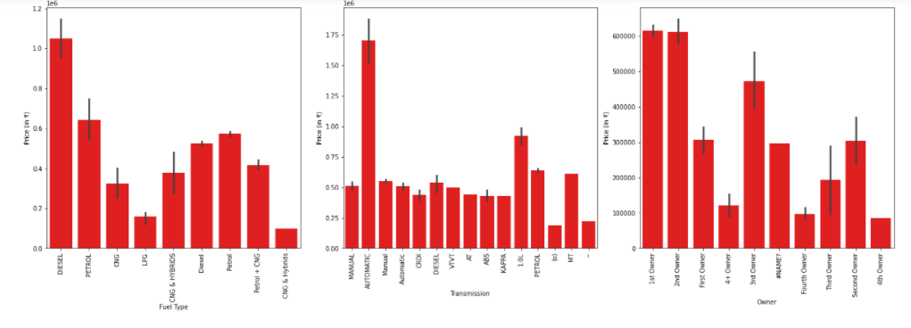
Bar graph
Since Brands, Varients, Driven Kilometers & Location have a wide range of values in them, we will not perform bivariate analysis for them as they will not give us any specific details. Now by plotting graph of Fuel type, Transmission and Owner against Price, we conclude that Car that uses Diesel, have automatic Transmission and Has only 1 owner is more likely to have a high price.

Slide 11
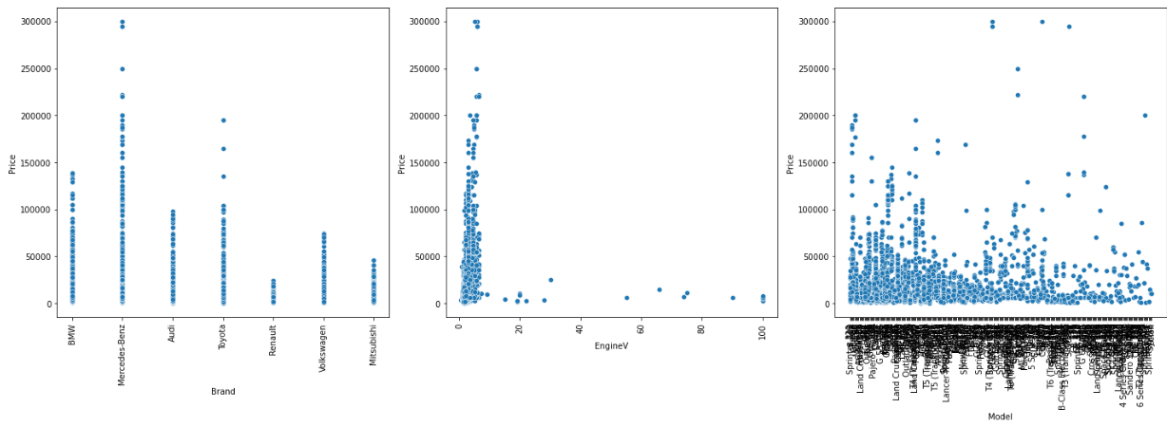
Scatter plot
Just like bar graph, we can see that Price range is likely to be high for cars using Diesel as fuel, or having Automatic Transmission or is owned by only 1 Owner.

Slide 12
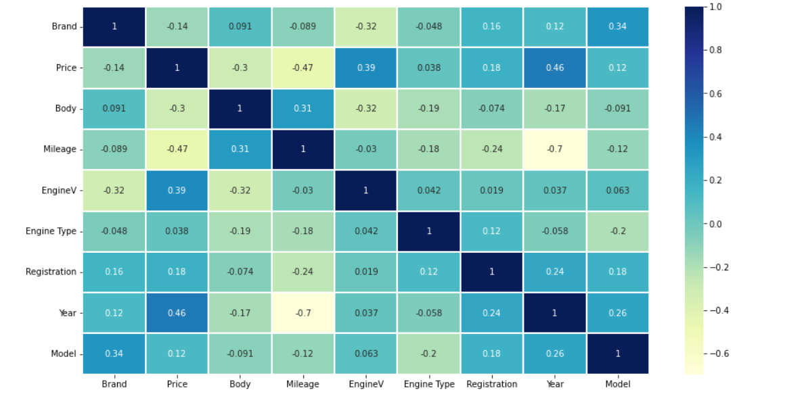
Heatmap
Heatmap suggests that there is no multi-collinearity in the dataset.

Slide 13
Model building
The models used training and testing datasets are as followed:
SVR
Linear Regression
SGD Regressor
KNeighbors Regressor
Decision Tree Regressor
Random Forest Regressor
Only Decision Tree Regressor and Random Forest Regressor are performing well and giving accuracy of 80.2 % and 87.7% , respectively.

Slide 14
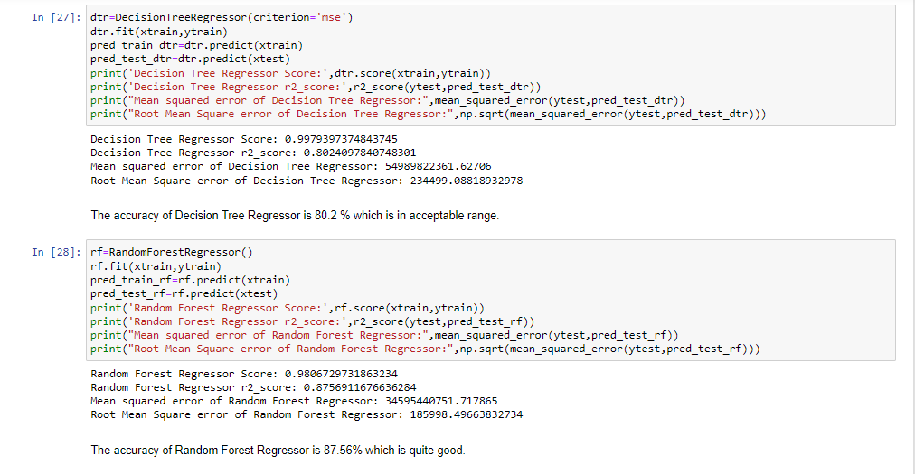

Slide 15
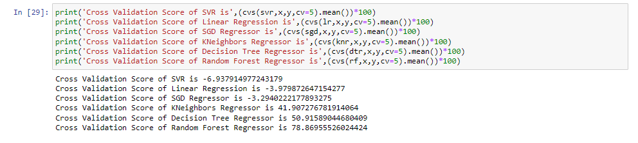
Cross validation score
After comparing r2_score and Cross validation score, we will select Random Forest Regressor for Hyper Parameter Tuning.

Slide 16
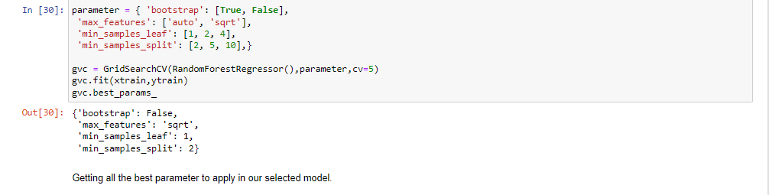
Hyper parameter tuning

Slide 17
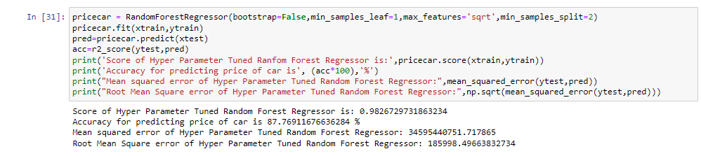
Final model
The accuracy of Model 'PriceCar' (Random Forest Regressor) after applying Hyper Tuned Parameters is found to be 87.79% and the score is 0.98 which is quite good.

Slide 18
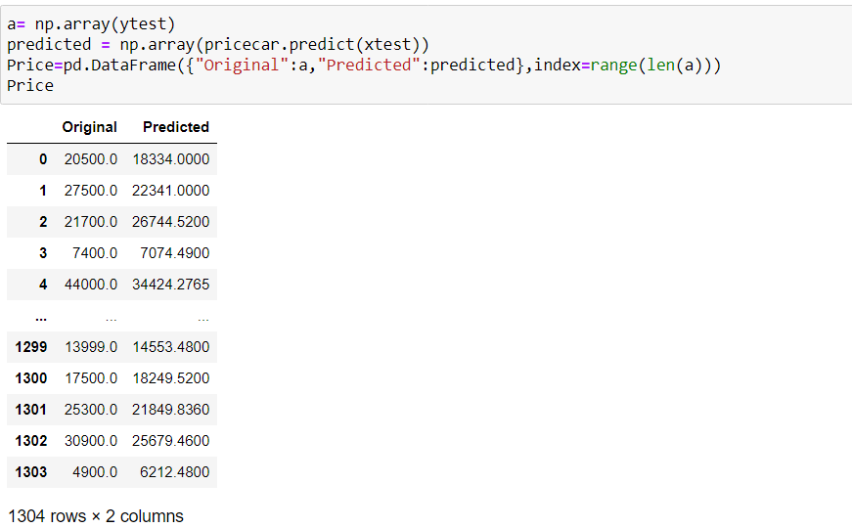
Conclusion
Here, we can see that all the predicted prices are either equal or nearly equal to the original prices of the car. Hence we conclude that our model 'pricecar' is working very well. And we shall save it for further use.

Slide 19
Limitations of this work and Scope for Future Work
As a part of future work, we aim at the variable choices over the algorithms that were used in the project. We could only explore two algorithms whereas many other algorithms which exist and might be more accurate. More specifications will be added in a system or providing more accuracy in terms of price in the system i.e.
1) Horsepower
2) Battery power
3) Suspension
4) Cylinder
5) Torque

Slide 20
Thank you

